Slide 1
SITE PLANNING 101
ORB University
EVERY PROJECT STARTS AS A SITE
ORB UNIVERSITY – MARCH 29, 2023
PRESENTED BY Tim Rice and Peter Gormley

Slide 2
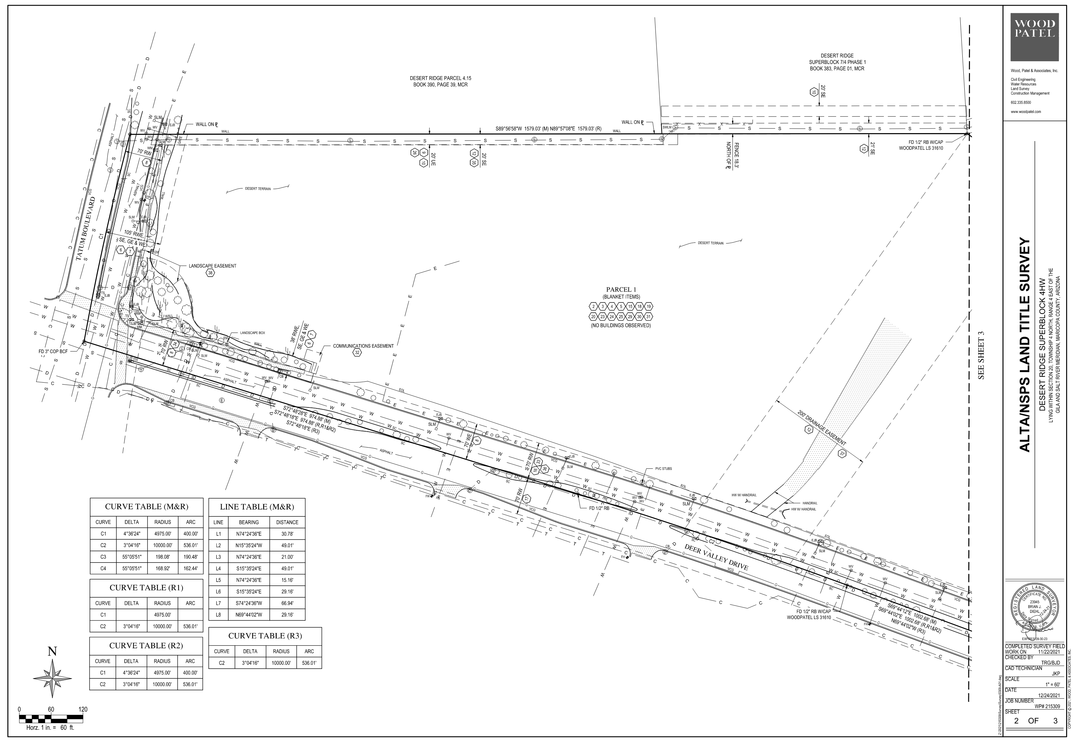
INITIAL SITE DATA
American Land Title Association (ALTA) Survey
Owner Provided
Attached to the Property Sale/ Title Documents
Meets & Bounds/ Property Line (Net)
Coordinates and Segment Lengths
Established Easements
Right-of-Way
Utility

Slide 3
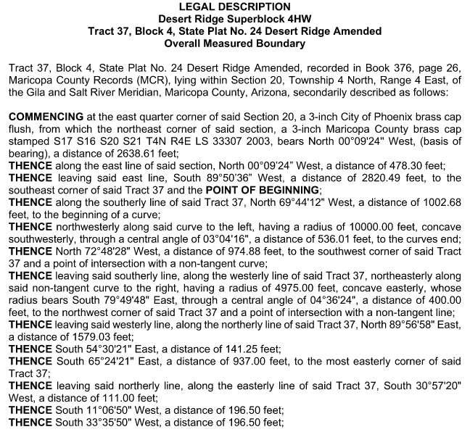
INITIAL SITE DATA
INITIAL SITE DATA
Legal Description
Owner Provided
Exhibit to Property Sale/ Title Documents
Describes Meets & Bounds/ Property Line (Net)
Coordinates and Segment Lengths
Should Match those on ALTA Survey
Updated to conditions present at the time of sale
Required to be included, verbatim, on Site Plan submittals

Slide 4
INITIAL SITE DATA
COUNTY ASSESSOR PARCEL MAP
Provides Assessor Parcel Number (APN)
Standard Nationwide
Lists recorded parcel area (NET)
Measured to buried markers
Sometimes use permanent site features
Fire Hydrants
Shared Utility Equipment
Different documents may state area differently
City will follow area STATED on the Site Plans
Property Owner’s Name & Address
Can lag following sale
Name, Address & Contact must be provided on applications
Owner Authorization Form
Used to generate Buffer Maps/ Mailing Lists
Current Property Zone

Slide 5
INITIAL SITE DATA
DIGITAL MAPPING
Most current as-built conditions in most cases
Existing Structures
Site Features
Utility Equipment
Surrounding Context
City of Phoenix allows marked up view as Preliminary Application Site Plan

Slide 6
ZONING
Zoning Code
Defines all Zone Classifications and uses permitted and conditions site must confirm to within a particular area
Can be Municipality or County
Sections are cross referenced to each other
Zoning Class Definitions
Includes (but not limited to)
Uses Allowed
Building Height
Lot Coverage
Building Setbacks
Multi-family unit density
Parking density required
Zone must include all planned uses
In current development
Future expansion
Re-zoning processes vary
Hearings at various levels
Public notifications/ meetings
Need to be considered in project schedule
Re-zoning efforts are NEVER guaranteed

Slide 7
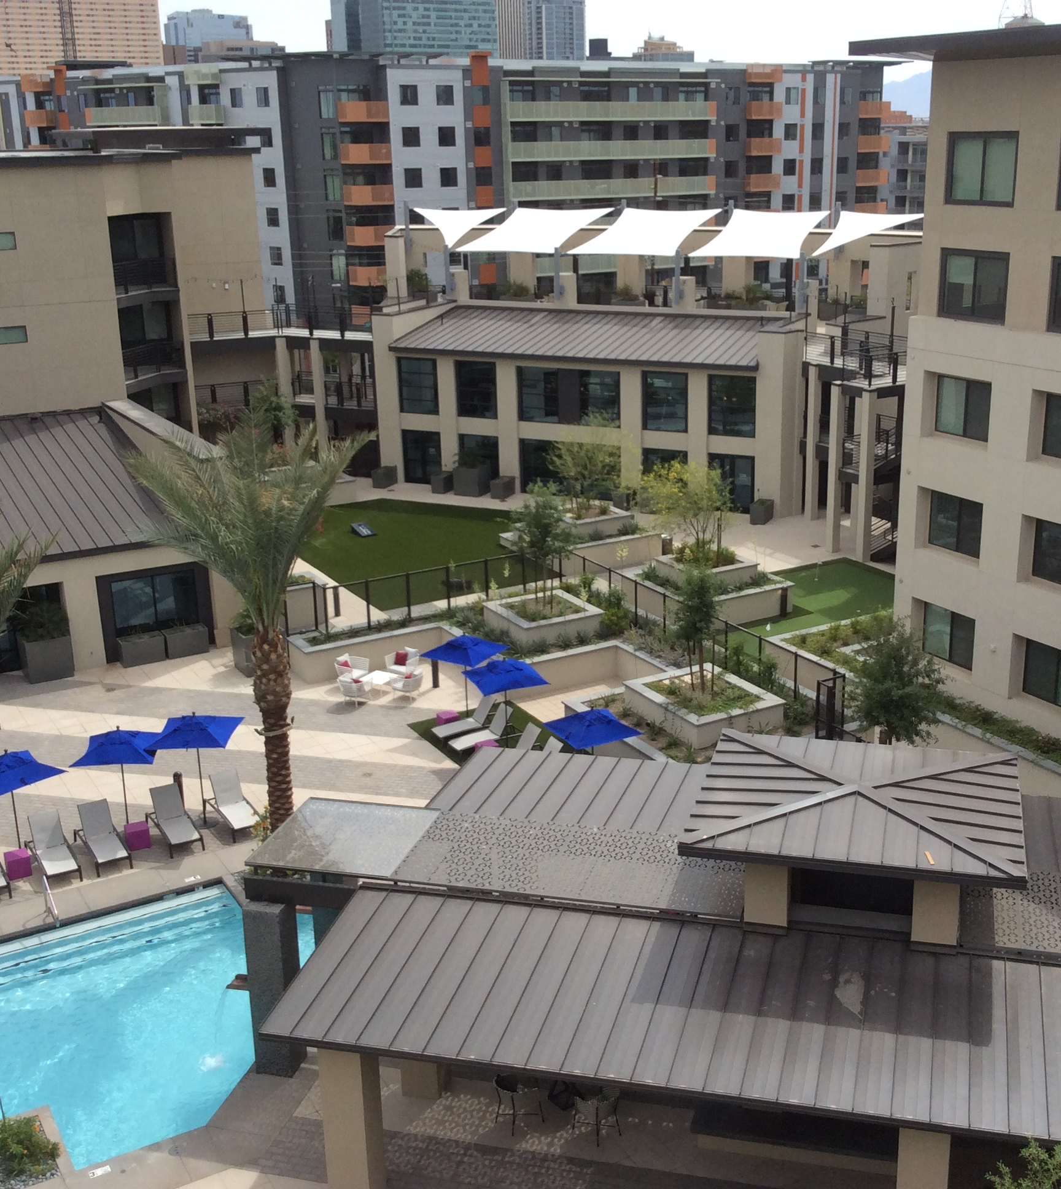
Building Type Considerations
Mixed Use Sites
What are the building types and uses being included on the parcel?
This is dictated by the owner/developer’s proforma
Mixed-Use Sites
More than one use needs to be considered by separate Building
Mixed-Use Buildings
All uses within one building need to be considered overall
Building Types
Garden
Wrap
Townhome
Podium
Amenity Building – Clubhouse/Leasing
Mixed-use within one building

Slide 8
Parking Considerations
Surface Parking vs. Parking Garages
Commonalities (defined by county or municipal codes)
Standard stall dimensions
90 degrees
Angled
Parallel
Single/Tandem
Aisle Widths
Mono or Bi-Directional
Vary based on stall direction
If part of Fire Access Route – City will typically determine required width
Overall Stall Counts
By Unit Type (number of bedrooms) and Count for Multi-Family
By Usage and Square Feet for other Uses

Slide 9
ADA Parking Stalls
Should always be located in the most convenient location for the user traveling to their final destination point.
When possible, accessible spaces should always be located in covered areas.
Stall Size
Loading Aisles – size determined by municipality
Signage
Surface Markings
Counts
2% of each type provided
Mandated by ANSI 117A
Access via Accessible Path of Travel

Slide 10
Surface Lot Considerations
Landscaping Islands
Width
Planting Materials
Planting Coverage
Frequency
Number of spaces between islands
Parking Shade Covers
Ratio of Covered vs. Open
ADA requires 2% or equal to overall ratio of covered to open
Parking Garage Considerations https://www.pci.org/PCI_Docs/Project_Resources/Parking_Structures/Parking%20Structures%20Recommended%20Practice%20in%20Design%20and%20Construction.pdf

Slide 11
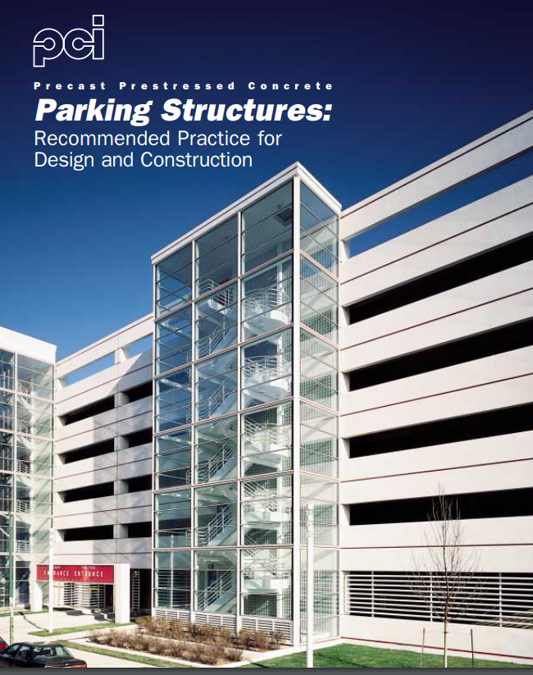
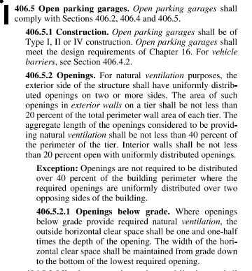
Parking Garage Considerations https://www.pci.org/PCI_Docs/Project_Resources/Parking_Structures/Parking%20Structures%20Recommended%20Practice%20in%20Design%20and%20Construction.pdf
Ground Level Location
Surface
Underground
Ventilation
Open
Mechanically Ventilated
IBC 406.5

Slide 12
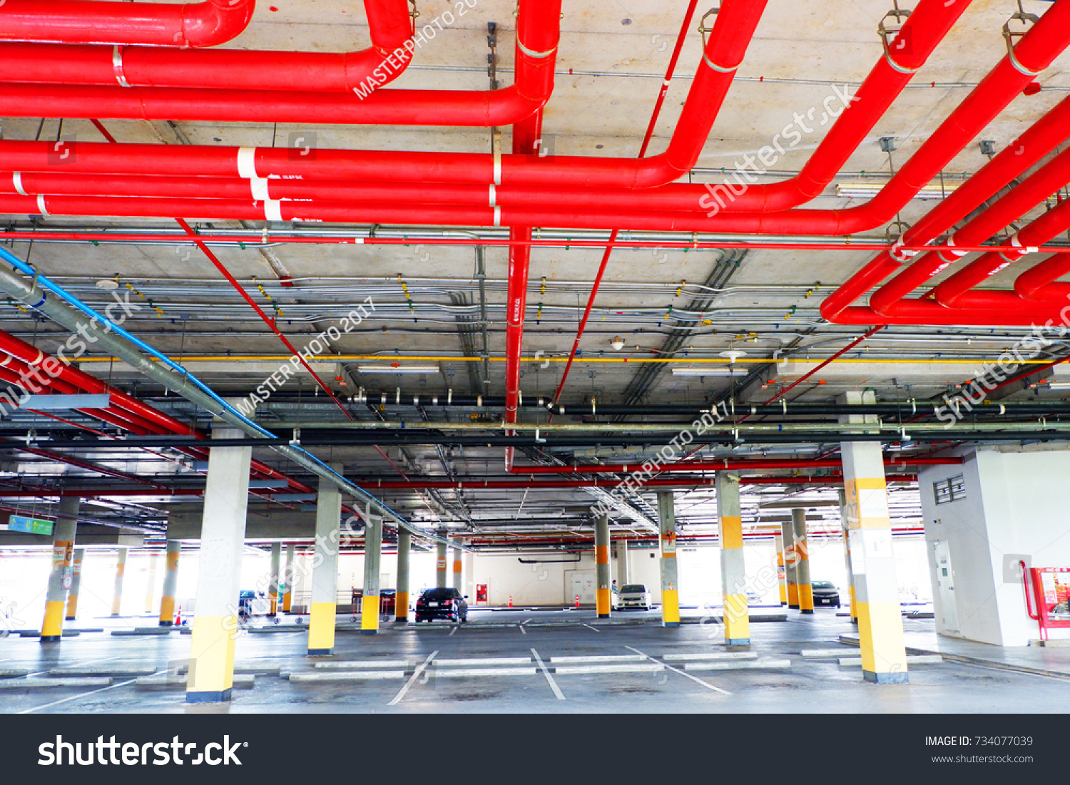
Minimum Overhead Height Clearance
Construction Method
PreCast Double Tees
T-Pac
Coreslab
Floor-to-Floor Height
Van Accessible requires 8’-2” Min.
Maximum Efficiency
+/-308 sf/car
Mechanical & Plumbing
Sprinklers
Lighting
Piping for units built overhead
Ramps
Width
Length
Ramp length of 160’-180’ most efficient
Slope
Speed Ramps typically <14%
May require transition slope at top and bottom.
Maximum slope of a ramp that incorporates parking 6.67%

Slide 13
Ventilation
Open
Area open to the Outside
Minimum SF defined by IBC Section 406.5
Closed
Needs Mechanical Ventilation
More costly than Open structure
Floor-to-Floor Alignment
Considered in a wrap building
Occupancy Separations
Pedestrian Access
Stairs
Elevators
Ramps

Slide 14
Loading Zones
10’x30’ Dedicated for Loading Only
Verify with municipality
Part of Phoenix Zoning Code Section 702 Off-Street Parking and Loading
Striped Area
Posted for Loading Use and No Parking Allowed
Do not require deceleration or pull-in/out lanes
Number of zones required determined by overall unit count

Slide 15
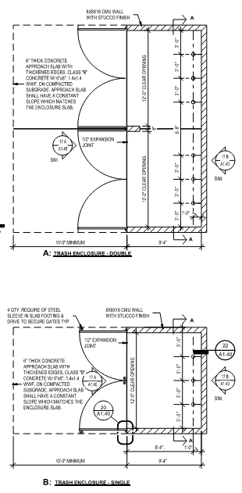
Solid Waste Disposal
Can be a department separate from Planning and Zoning Departments or private collector
Can require separate submittal, review, and approval
Surface / Garden Sites
Municipality may have developed set of guidelines
Bin size and number required can be a calculated volume
By unit count / size
By square footage
Bin enclosure design can be mandated by code
Most are similar, but can be unique & varied
Must be determined by municipality

Slide 16
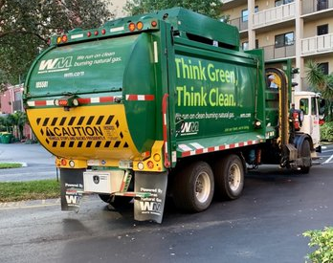
Collection Vehicle Access Requirements
Security Gate Access
Turning Radii
Drive Aisle Width
Defined Access Route
Enclosure Approach Angle
Parking Garages / High Rises
Trash Chutes
Termination Bins / Compactors
Collection Vehicle Access

Slide 17
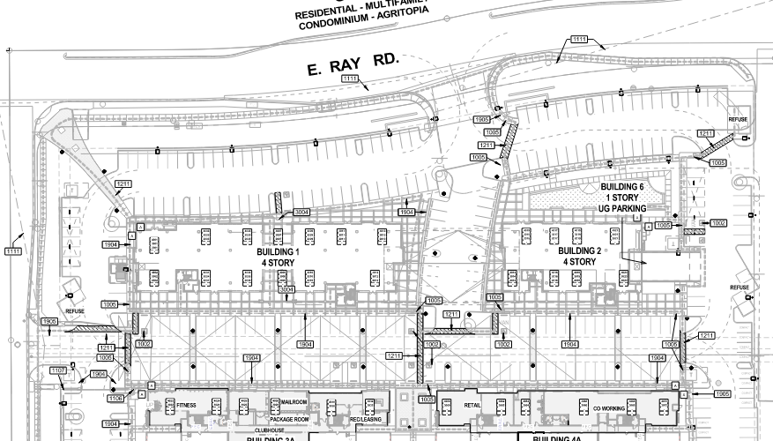
Site Accessibility
Accessible Path of Travel
Provided from Building Egresses
To Accessible Parking
Accessible Pedestrian Route
Through Entire Site
Must Connect to Public Way
To Provided Site Amenities
Amenities Building (Clubhouse)
Playgrounds
Pool / Spa
Central Mailboxes
Parcel / Package pick-up rooms
Trash Enclosures
Central Laundries

Slide 18
Walkways
Defined system to interconnect all parts of the development
May be required to connect to larger system
City Walkways
Trail and Path System
Have defined methods of Construction Allowed
Width
Minimum is 3’-0” for ADA access
5’-0” is most common, unless unable
Allowed to slope for drainage
Ramps
Max. slope of 1:12
Max. rise for any run 30”
5’ Landings used to break up runs
Handrails are required
Stairs
Handrail required for more than (2) steps
(2) risers with (1) tread are allowed within path of travel
Can be safety rolled over
Curb Step Offs
Accessible ramp must be provided at curb step-off along Path of Travel
Designs are mandated by municipality codes
Depth/ slope and surface treatment can vary

Slide 19
Vehicle Access/ Parking Screening/ Landscape/ Utilities
Utilities
Typically located within existing underground easements
New services are not allowed to cross property lines
Can be allowed as part of a signed and recorded Access Agreement
Electrical Transformers
Require access from Utility Department
Coordinated directly with utility provider
Separate submittal and approval process
Proximity to buildings a consideration
Considered hazardous
Mandated by utility
Based on capacity of transformer
Require rated protection if placed too close
Often required to be screened
Physical barrier
Landscaping

Slide 20
Parking Lot Screening
Most parking is required to have screening of stalls
Wall and/or fence designs may have design standards imposed by municipality
Heights are mandated to prevent view obstruction
Low walls used to prevent headlight glare
Visibility Triangles
Fences/ Walls with Security Gates
Gates may have design standards imposed
Must provide Queuing Distance
Space for gates to open
Does not allow traffic to obstruct public ways
Operable for emergency, solid waste, utility and mail services
Also for delivery and ride sharing services
Landscaping
Minimum Coverages
Shade can be mandated
Species Allowed
Determined in conjunction with inventory/ Salvage submittal process
Landscape Buffers
Can be mandated as Setback requirements
Parking Islands
Size of island
Planting volume required
Frequency between stalls

Slide 21
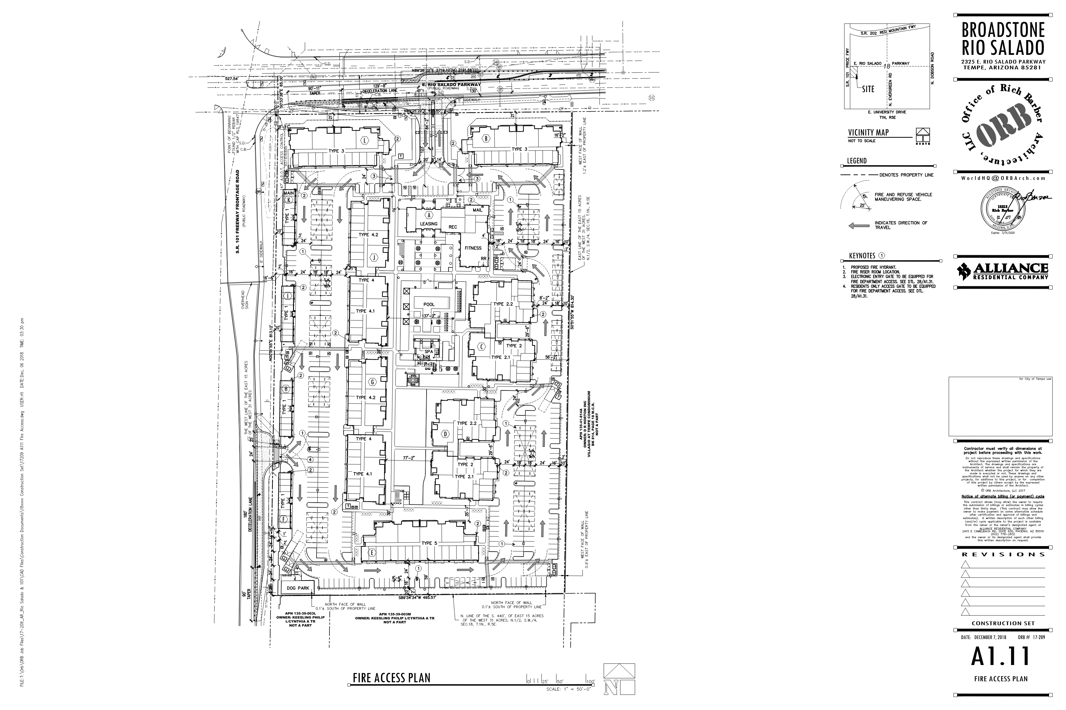
FIRE DEPARTMENT ACCESS
Access Loop
Circular route through entire site
Access to all buildings
Min. aisle widths must be maintained
Kept clear via signage and curb painting
20’ typically
18’ min. in some jurisdictions
Mono direction
Fire Only Lanes
Turning Radius
Minimum inside, center and outside dimensions
Dimensioned on Site Plan/ Fire Access Plan

Slide 22
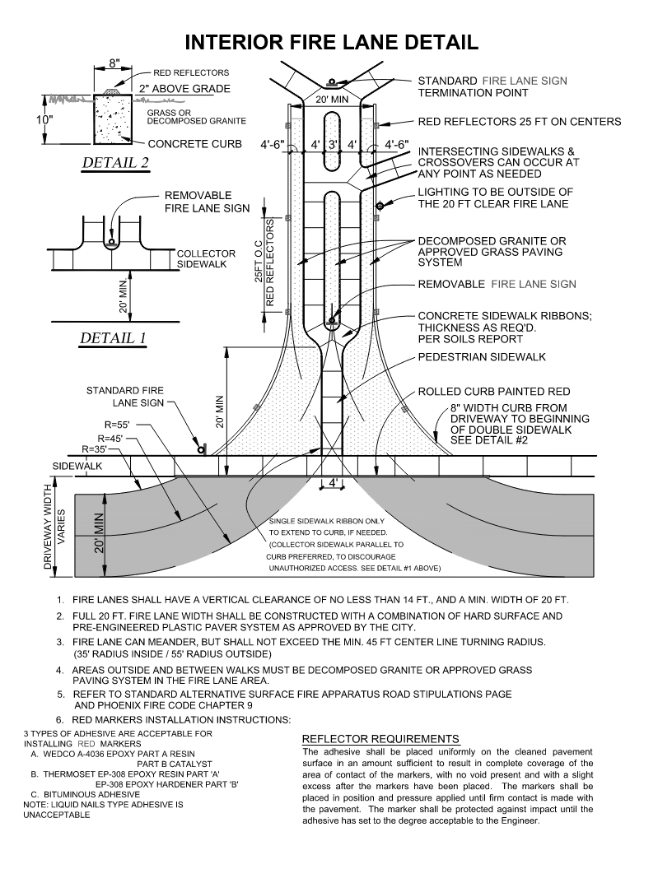
Dedicated Fire Lanes
Minimum Widths
Maximum lengths to dead ends
Under 150’ to back out
Turn-around or cul-de-sac required for longer lanes
Required when buildings are more than 250’ from Fire Access Route
Can be of alternative materials
Decomposed granite
Grass Paving systems
Building Addressing
Approved Addressing Exhibit required with Site Plan
Must be approved as will be used in Fire Alarm Panel and 911 notifications
Building Address Signage
Location must follow the standards of the Fire Department/ Jurisdiction
Locations shown on Exterior Elevations
Minimum standards for letter/ character heights
High contrast
Font
Must match approved Addressing Exhibit

Slide 23
Hydrants
Existing Public hydrants located on Site Plan
Also on Civil Utility and ALTA Surveys
Flow Test required to confirm pressure at existing hydrants
Private hydrants are required on site
Spacing mandated by City codes
From nearest public hydrant
Between locations on site
Fire Riser Rooms
Identified on building exterior by signage
Accessible from building’s exterior
Remote Fire Department Connections (FDC) may be required
If room is located too far from hydrant

